Slide 1


Slide 2
Cynosure
Linear regression Using Gradient descent
Under the guidance of
Ms. Niharika Singh
Dhruv Singhal 500075346 R177219074
Dipanshu Yadav 500076009 R177219077
Ghanisht Pareek 500076448 R177219084
Jasleen 500076007 R177219094

Slide 3
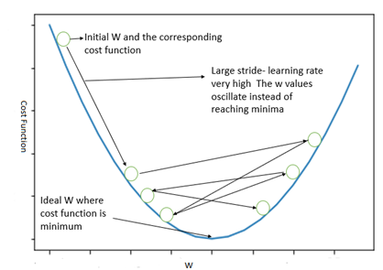
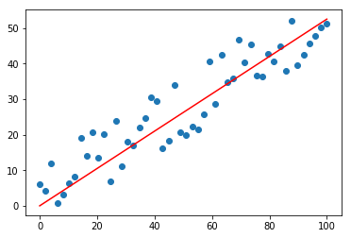
Introduction
In statistics, linear regression is a linear approach for forming a relationship between a scalar response to other independent and dependent variables. When there is a single input variable, the approach is termed as Simple Linear Regression, whereas when there are multiple input variables, it is termed as Multiple Linear Regression
Gradient Descent is a first order iterative optimization algorithm that finds a local minimum of a differentiable function. It is an algorithm that finds the best-fit line for a given training dataset in a smaller number of iterations.
Linear Regression with Gradient Descent
The aim of the learning process is to optimize the objective function. Gradient Descent is one of the supervised machine learning techniques that optimizes the cost function in the learning process.

Slide 4
Scope of Project
Objectives:
In statistics, linear regression is a linear approach for forming a relationship between a scalar response to other independent and dependent variables.
The objective is to minimize the cost function and is defined as to understand the weights by using sum of squared errors between trained set and real outcomes.
The cost function defined is convex and powerful called gradient descent (incremental) to determine the minimum cost to classify the samples in the dataset. Partial derivation is computed on the cost function with respect to each weight.

Slide 5
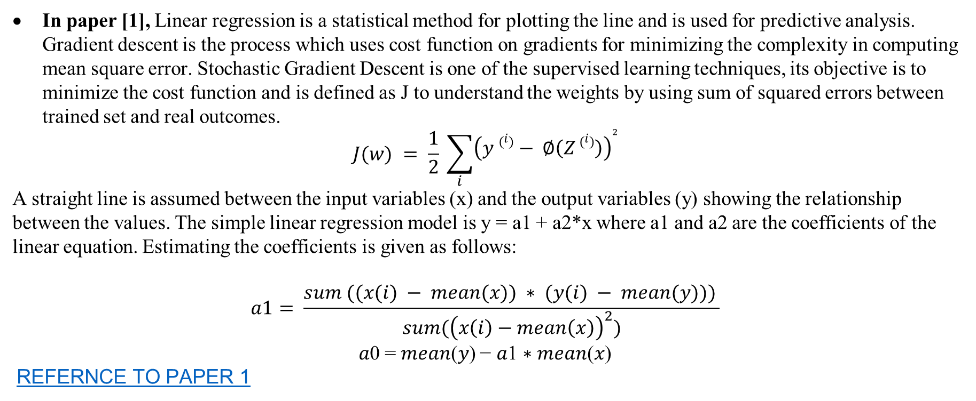
Literature Survey
In paper [1], Linear regression is a statistical method for plotting the line and is used for predictive analysis. Gradient descent is the process which uses cost function on gradients for minimizing the complexity in computing mean square error. Stochastic Gradient Descent is one of the supervised learning techniques, its objective is to minimize the cost function and is defined as J to understand the weights by using sum of squared errors between trained set and real outcomes.
$$J(w) = \frac{1}{2} \sum_{i}{{\left(y \left(i\right)− ∅\left(Z \left(i\right)\right)\right)}^{2}}$$
A straight line is assumed between the input variables (x) and the output variables (y) showing the relationship between the values. The simple linear regression model is y = a1 + a2*x where a1 and a2 are the coefficients of the linear equation. Estimating the coefficients is given as follows:
$$a1= \frac{sum ((x(i) − mean(x)) ∗ (y(i) − mean(y))) }{sum({\left(x\left(i\right)−mean\left(x\right)\right)}^{2})}$$
𝑎0 = 𝑚𝑒𝑎𝑛(𝑦) − 𝑎1 ∗ 𝑚𝑒𝑎𝑛(𝑥)
REFERNCE TO PAPER 1

Slide 6
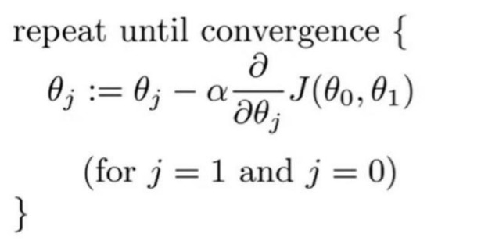
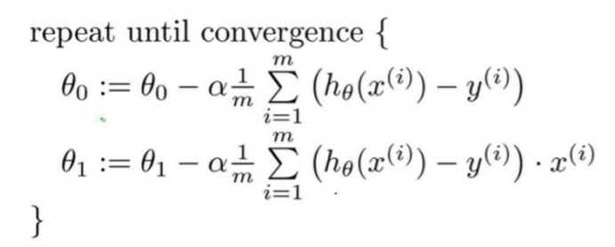
Literature Survey
In paper [2], The gradient descent algorithm is an optimization algorithm that can be used to minimize the above cost function and find the optimized values for the linear regression model parameters. For just two parameters (as in simple linear regression), the gradient descent algorithm is:
After we partially differentiate the cost function J(θ0 , θ1 ) for j=0 and 1, the algorithm is:
Feature scaling
If you run the algorithm without feature scaling, it will take a very long time to reach
the global minimum.
1. No need to do feature scaling if there is only one predictor variable.
2. Do feature scaling if predictors have very different scales such as 1:100, 1:1000.
3. Do feature scaling only for predictors. No need to apply feature scaling for the response variable even
if it has a very different scale.
4. A common technique for feature scaling is mean normalization which involves subtracting the
average value for an input variable and divide that result by the standard deviation of that variable
REFERENCE TO PAPER 2

Slide 7
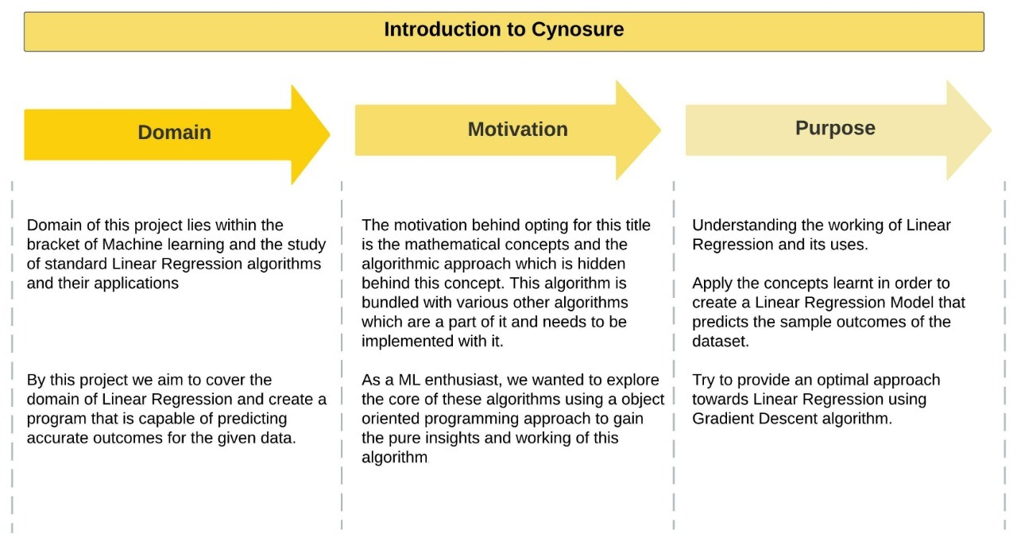

Slide 8
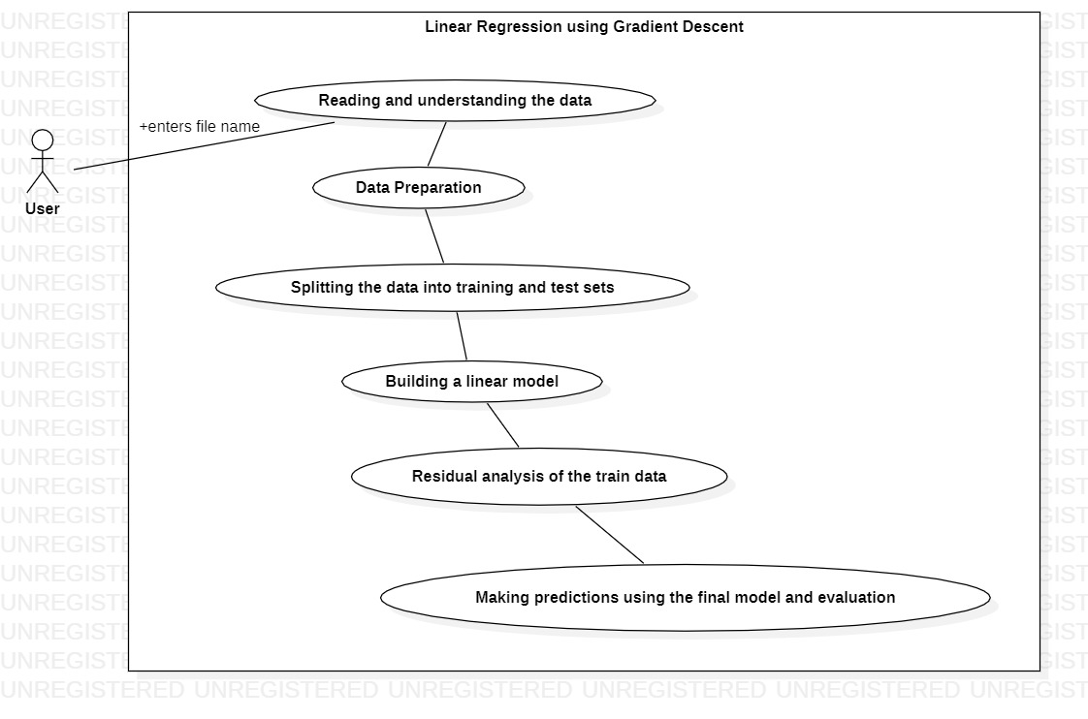
Design of Experiment use case diagram
Notes:
This is a flowchart of our design.

Slide 9
Steps Involved in Linear Regression with Gradient Descent Implementation
Initialize the weight and bias randomly or with 0(both will work).
Make predictions with this initial weight and bias.
Compare these predicted values with the actual values and define the loss function using both these predicted and actual values.
With the help of differentiation, calculate how loss function changes with respect to weight and bias term.
Update the weight and bias term so as to minimize the loss function.

Slide 10
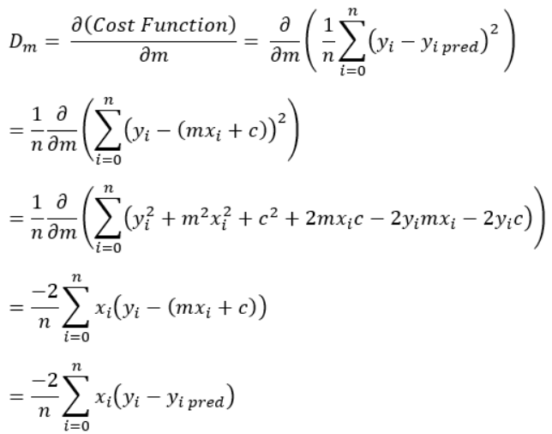

Step by Step Algorithm:
1. Let m = 0 and c = 0. Let L be our learning rate. It could be a small value like 0.01 for good accuracy.
2. Calculate the partial derivative of the Cost function with respect to m. Let partial derivative of the
Cost function with respect to m be D_{m} (With little change in m how much Cost function changes).
3. Now update the current values of m and c using the following equation:
4: We will repeat this process until our Cost function is very small (ideally 0).
REFERENCE TO THE SOURCE

Slide 11
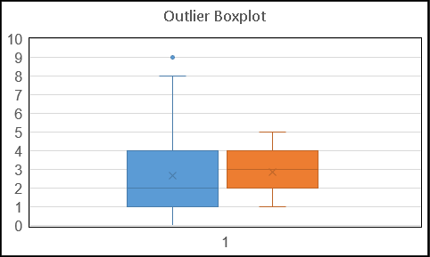
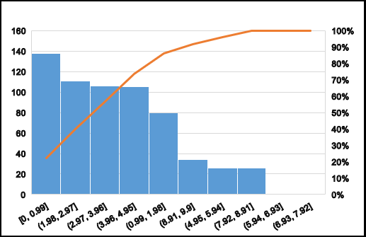
Data Visualization
Data Histogram

Slide 12
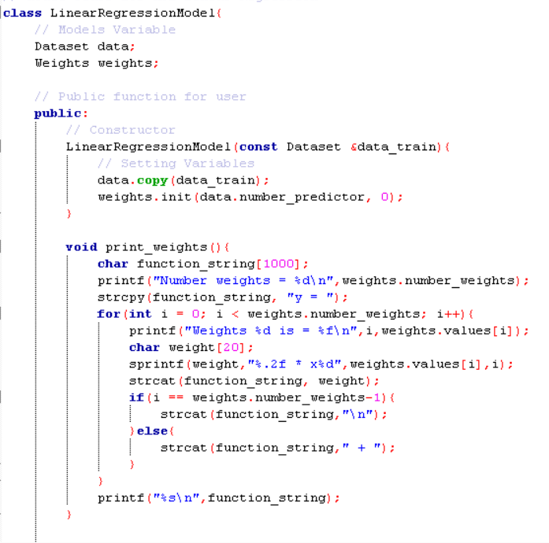
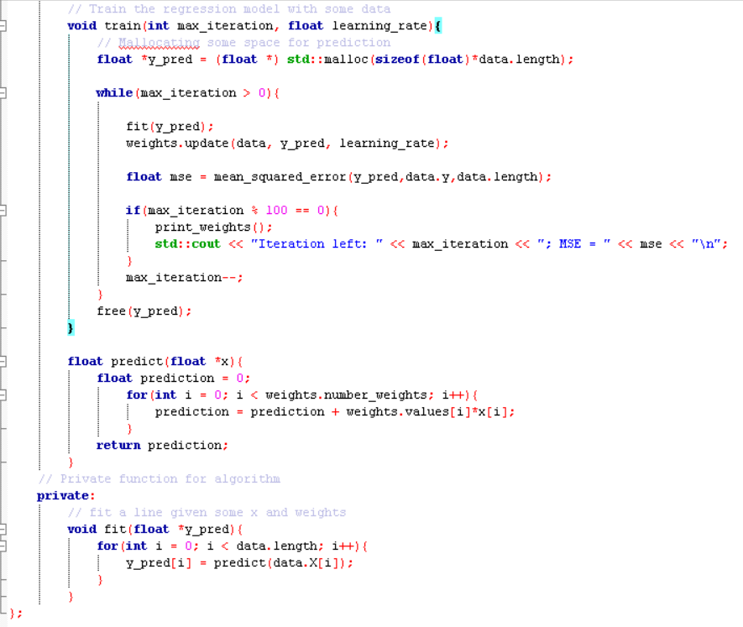
CODE SNIPPETS:
Linear regression Class

Slide 13
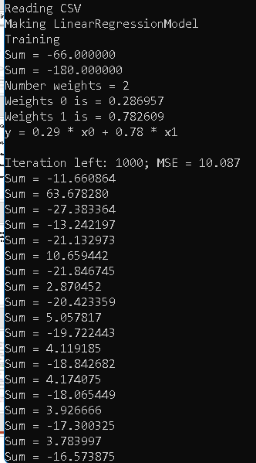
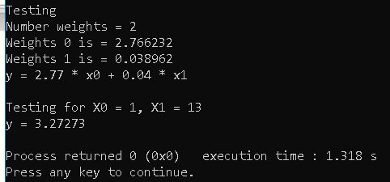
OUTPUT SNIPPET: Testing Phase Training Phase :

Slide 14
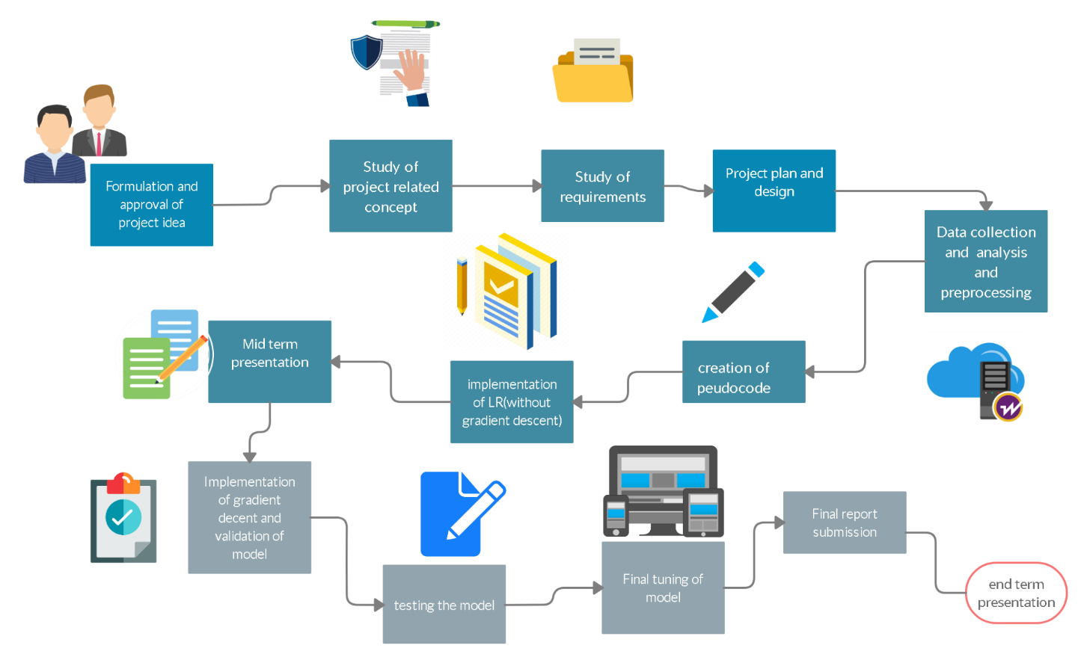
Plan of Work

Slide 15
References
[1] Stochastic Gradient Descent using Linear Regression with Python, J V N Lakshmi, Research Scholar
Department of Computer Science and Application, SCSVMV University, Kanchipuram, India, 2016
[2] Linear Regression with Gradient Descent, Rukshan Pramoditha, 2020
Img Source:
https://insights.insofe.com/wp-content/uploads/2019/12/image-1.png
Algorithm Souce:
https://www.analyticsvidhya.com/blog/2021/04/gradient-descent-in-linear-regression/

Slide 16
THANK YOU

